Slide 1
Robots that can adapt like animals
Antoine Cully, Jeff Clune, Danesh Tarapore, Jean-Baptiste Mouret
28 MAY 2015 | VOL 521 | NATURE | 503

Slide 2
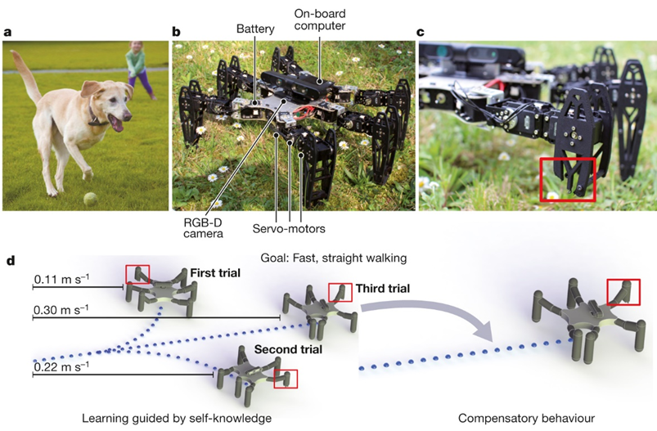
Figure 1 | Using the Intelligent Trial and Error (IT&E) algorithm, robots, like animals, can quickly adapt to recover from damage

Slide 3
Intelligent Trial and Error algorithm
The Intelligent Trial and Error Algorithm consists of two major steps：
1、the behavior-performance map creation step
2、the adaptation step

Slide 4
1、the behavior-performance map creation step
The step is accomplished via a new algorithm introduced in this paper called multi-dimensional archive of phenotypic elites (MAP-Elites).Under my understanding it is first a Dimensionality reduction process.
Dimensionality reduction process :
Parameters of a controller(servo) behavior of one leg of robot

Slide 5
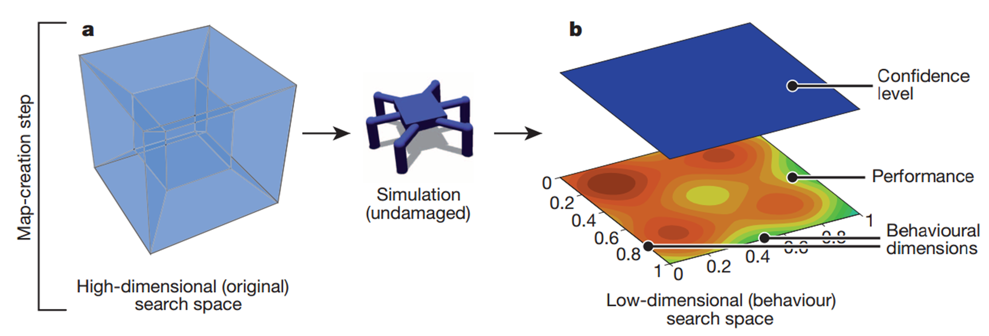
1、the behavior-performance map creation step
Behavior example : the portion of time that each leg is in contact with the ground . The behavioural space is discretized at five values for each dimension

Slide 6
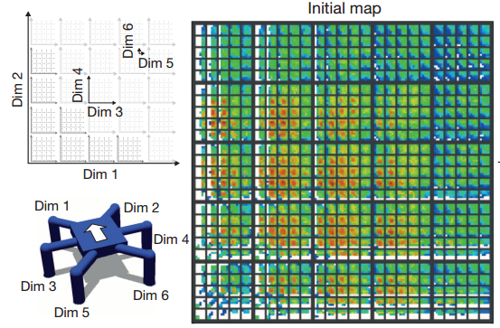
1、the behavior-performance map creation step
In the paper , the map is six-dimensional corresponding to the six legs of the robot . Every point in the map contains the following elements :
1)、controller(parameters of the servos)
2)、performance(eg. the speed of the robot)

Slide 7
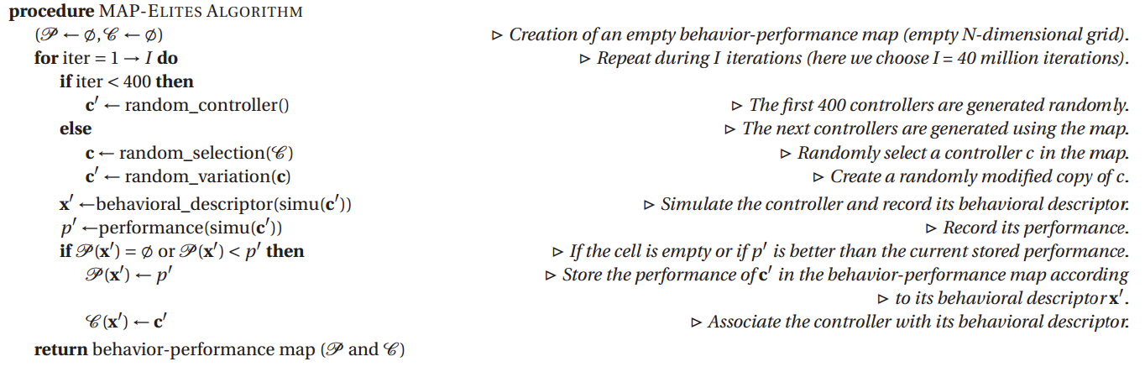
1、the behavior-performance map creation step
The pseudo-code of the MAP-Elites algorithm :

Slide 8
1、the behavior-performance map creation step
Because MAP-Elites is a stochastic search process, each resultant behavior performance map can be different, both in terms of the number of locations in the behavioral space for which a candidate is found, and in terms of the performance of the candidate in each location. In the experienment , seveal different behavior performance map had been created and used.

Slide 9
2、 the adaptation step
The step is accomplished via a new algorithm introduced in this paper called the map-based Bayesian optimization algorithm (M-BOA) . The key concept of M-BOA is to use the output of MAP-Elites as a prior for the Bayesian optimization algorithm
1、Bayesian optimization
2、Gaussian process
3、Kernel function
4、Information acquisition function

Slide 10
2、 the adaptation step
2.1 Bayesian optimization ：a model-based, black-box optimization algorithm that is tailored for very expensive objective functions , searches for the maximum of an unknown objective function from which samples can be obtained , creates a model of the objective function with a regression method, uses this model to select the next point to acquire, then updates the model . It is called Bayesian because, in its general formulation5, this algorithm chooses the next point by computing a posterior distribution of the objective function using the likelihood of the data already acquired and a prior on the type of function .

Slide 11
2、 the adaptation step
2.2 Gaussian process ：not only model the cost function(objective function), but also the uncertainty associated with each prediction . For a cost function f , usually unknown, a Gaussian process defines the probability distribution of the possible values f (x) for each point x. These probability distributions are Gaussian, and are therefore defined by a mean (µ) and a standard deviation (σ). However, µ and σ can be different for each x .
P(f (x)|x) = N (µ(x),σ2(x))
In this paper , x is one point in the map ,which indicates one special behavior of the robot . f (x) is the performance function.

Slide 12
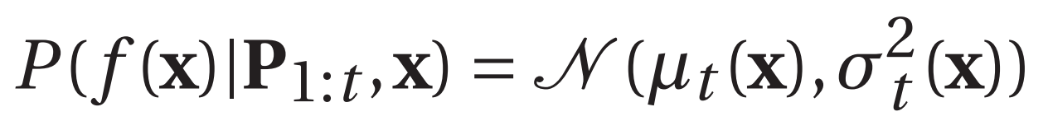
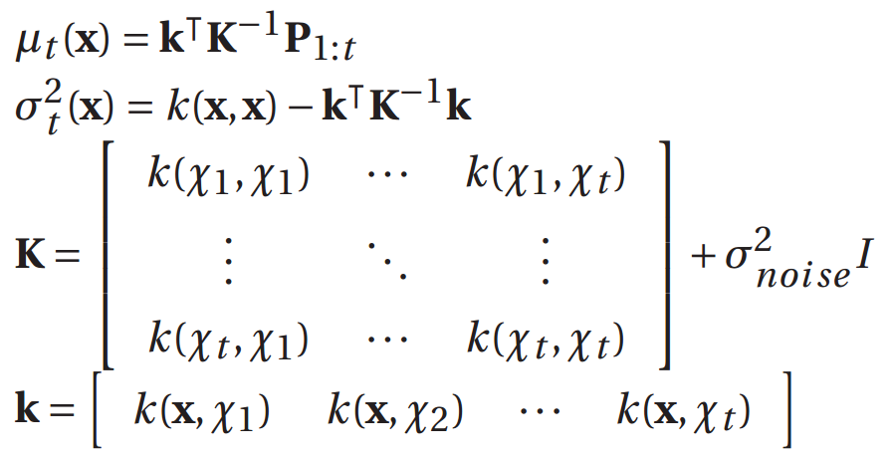
2、 the adaptation step
2.2 Gaussian process ：
Where :

Slide 13
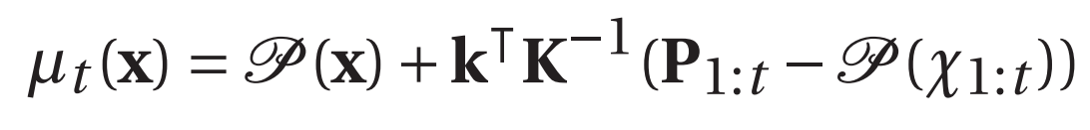
2、 the adaptation step
2.2 Gaussian process ：modifying the update equation for the mean function :
where P (x) is the performance of x according to the simulation and P (χ1:t ) is the performance of all the previous observations, also according to the simulation.
M-BOA therefore starts with the prediction from the behavior-performance map and corrects it with the Gaussian process.

Slide 14
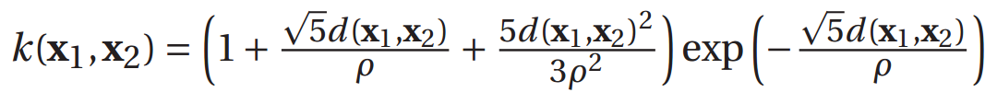
2、 the adaptation step
2.3 Kernel function ：The kernel function is the covariance function of the Gaussian process . It defines the influence of a controller’s performance (on the physical robot) on the performance and confidence estimations of not-yet-tested controllers in the behavior-performance map that are nearby in behavior space to the tested controller .
where d(x1,x2) is the Euclidean distance in behavior space.

Slide 15
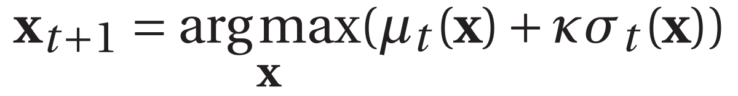
2、 the adaptation step
2.4 Information acquisition function ： The information acquisition function selects the next solution that will be evaluated on the physical robot. The selection is made by finding the solution that maximizes the acquisition function .
where κ is a user-defined parameter that tunes the tradeoff between exploration and exploitation .
The acquisition function handles the exploitation/exploration trade-off of the adaptation (M-BOA) step.

Slide 16
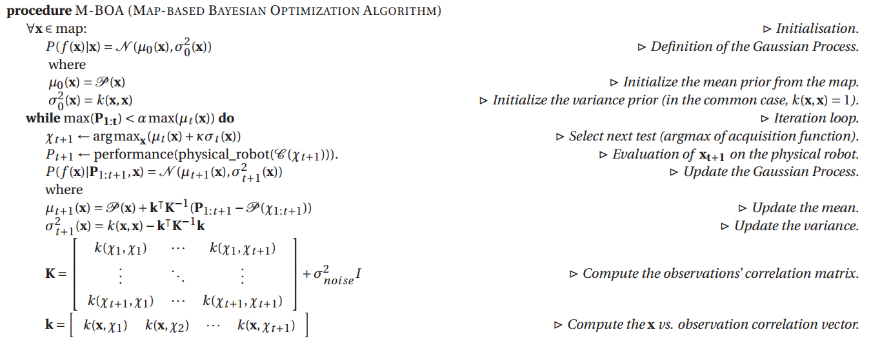
2、 the adaptation step
The pseudo-code of the M-BOA algorithm :

Slide 17
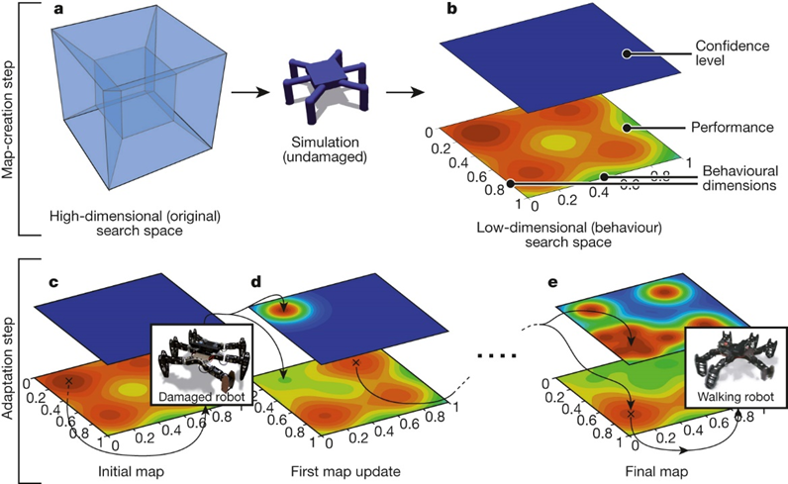
Figure 2 | The two steps of IT&E

Slide 18
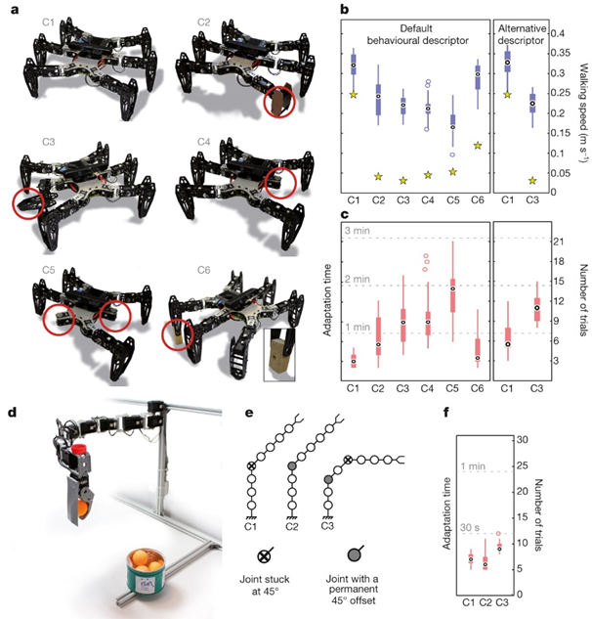
Figure 3 | Main experiments and results

Slide 19
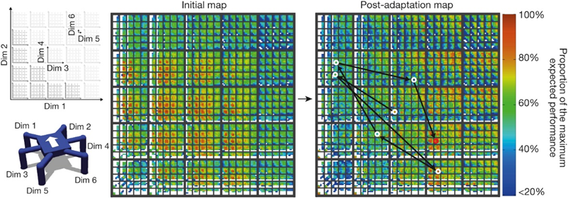
Figure 4 | An example behaviour–performance map

Slide 20
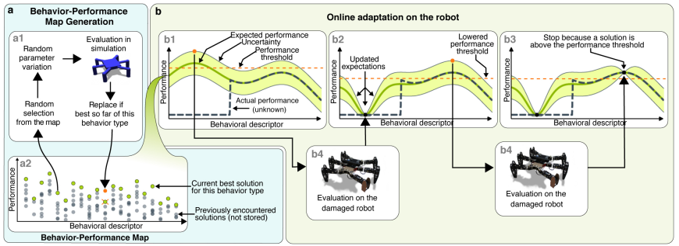
Extended Data Figure 1 | An overview of the IT&E algorithm

Slide 21
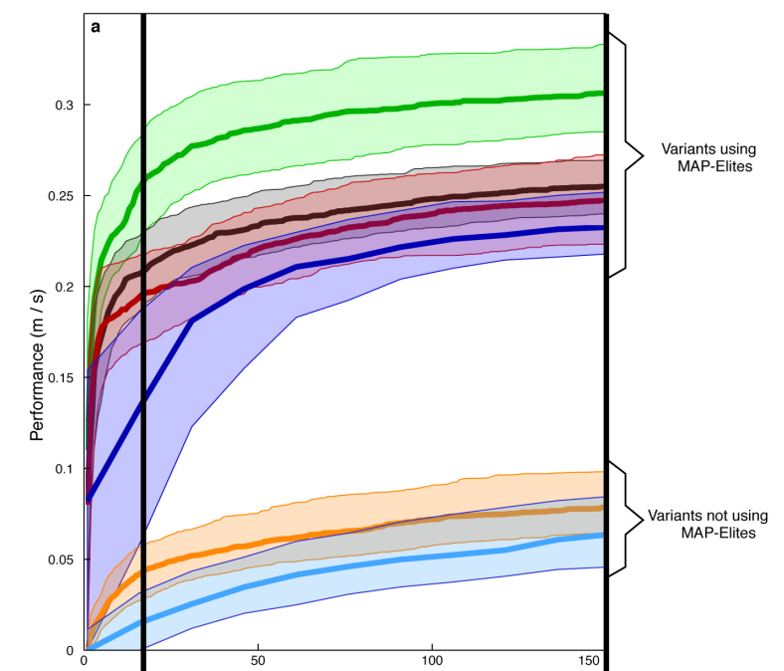
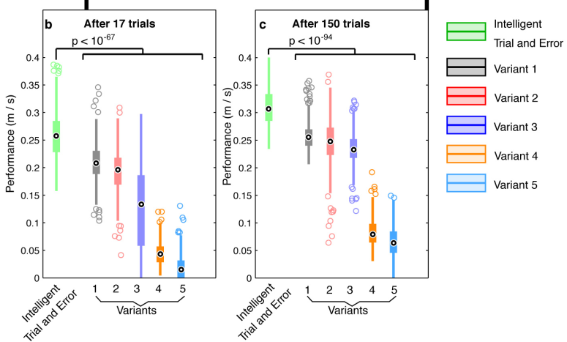
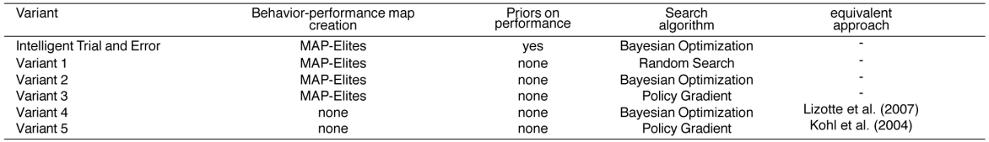
Extended Data Figure 2 | The contribution of each subcomponent of the IT&E algorithm

Slide 22
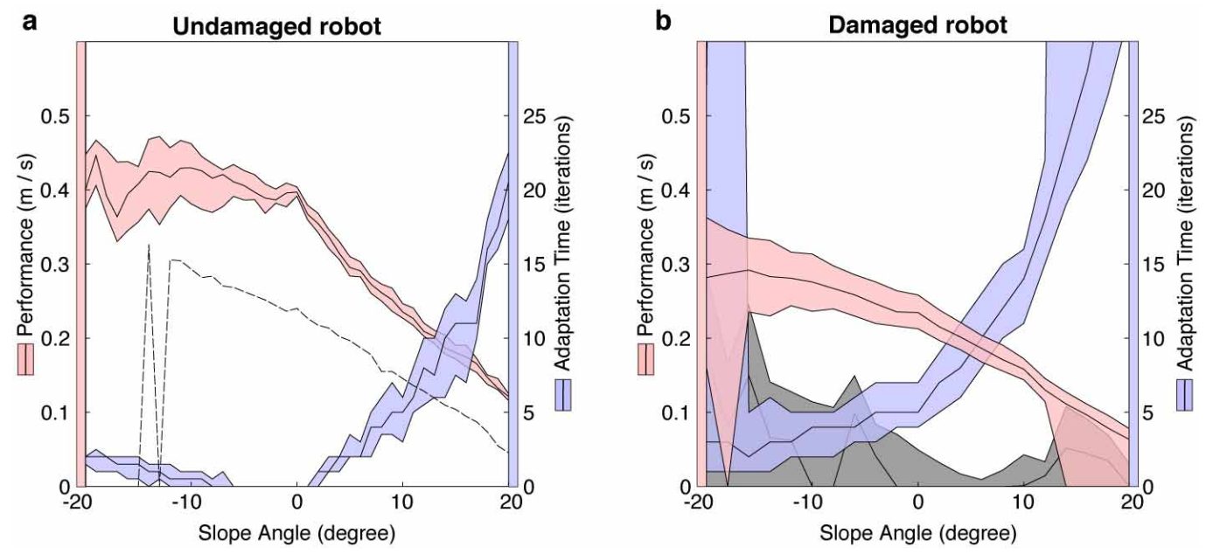
Extended Data Figure 3 | The IT&E algorithm is robust to environmental changes

Slide 23
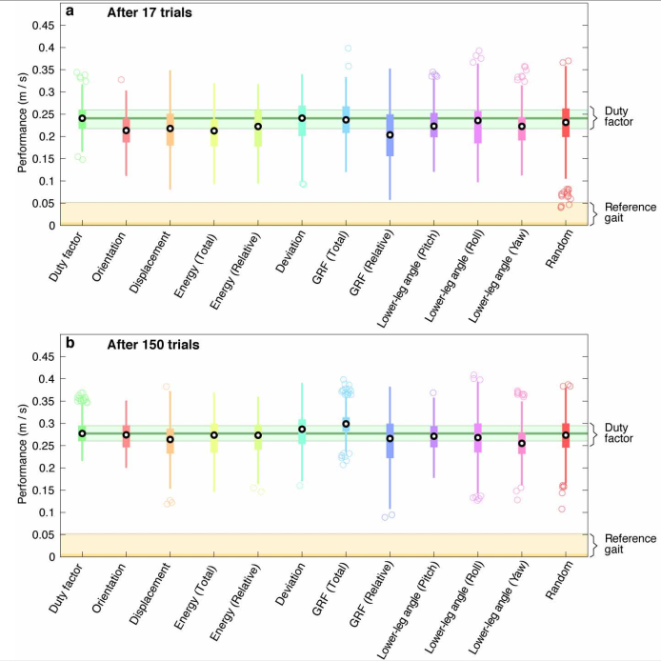
Extended Data Figure 4 | The IT&E algorithm is largely robust to alternative choices of behaviour descriptors

Slide 24
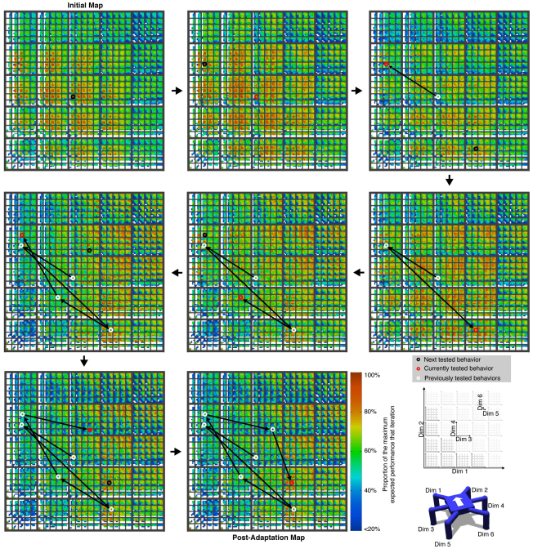
Extended Data Figure 5 | How the behavior performance map (data normalized) is explored to discover a compensatory behaviour

Slide 25
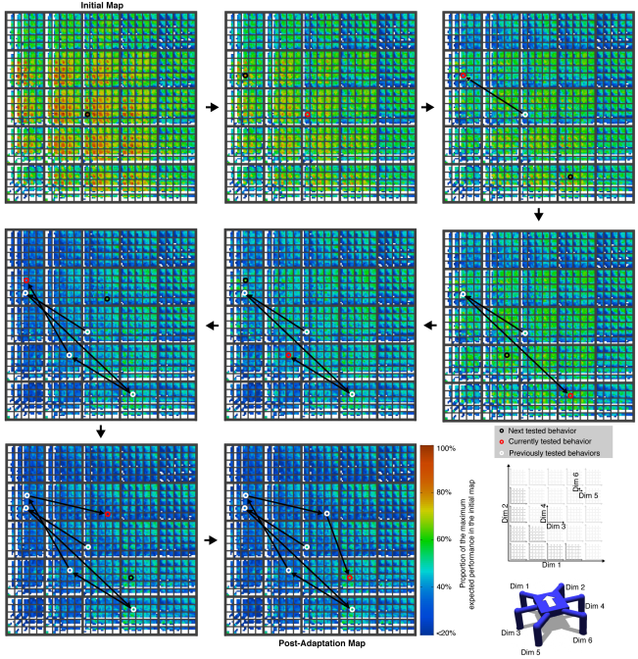
Extended Data Figure 6 | How the behaviour performance map (data not normalized) is explored to discover a compensatory behaviour

Slide 26
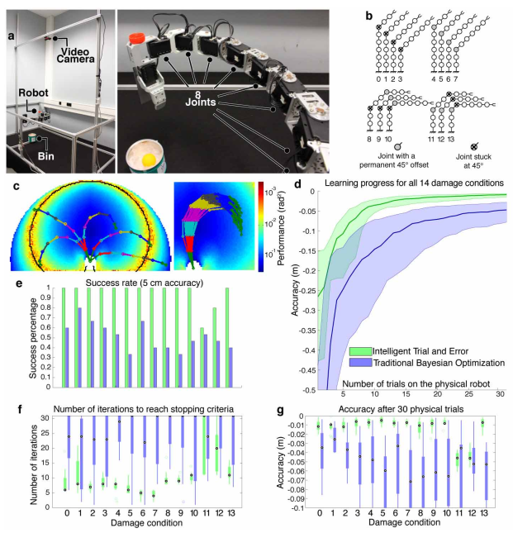
Extended Data Figure 7 | IT&E works on a completely different type of robot (the robotic arm experiment)
The news :
http://www.popsci.com/robot-learns-walk-damaged-legs
The sourse code :
https://github.com/resibots/cully_2015_nature

